Slide 1
Lesson 6 - Measures of Spread
Mack 2021

Slide 2
Measures of Spread
A measure of spread (dispersion) is used to describe how data is spread. It also describes the variability of the dataset.
Set 1 Set 2
7, 8, 9, 10, 11, 11, 12, 12, 13, 18 1, 1, 2, 3, 11, 11, 14, 22, 22, 24
Notes:
Measures of central tendency are great for providing information on the center of the data, but there is a lot more to consider when looking at datasets. It’s important to know how spread out, or disperse the data is. This helps to describe the variability of the dataset. Take a look here, both of these data sets have the same exact mean, of 11.1 and median of 11, but by just glancing at these two datasets we can tell that they are drastically different in terms of spread or dispersion. The first set has a lot less spread.

Slide 3
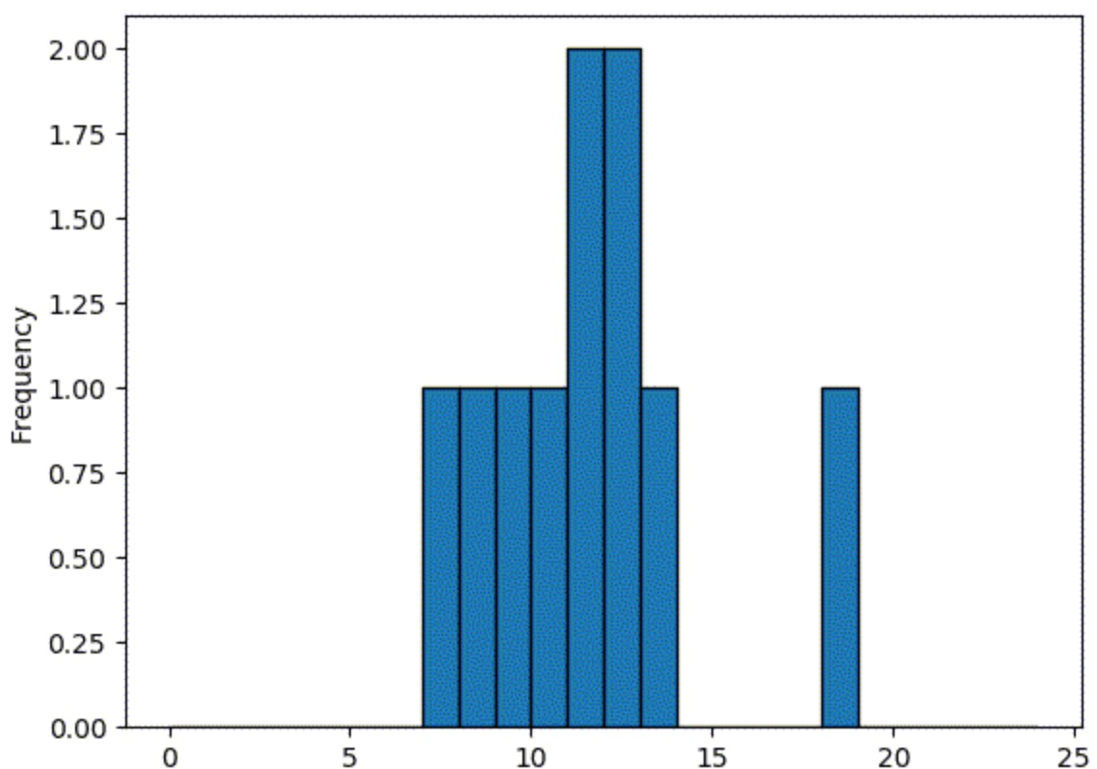
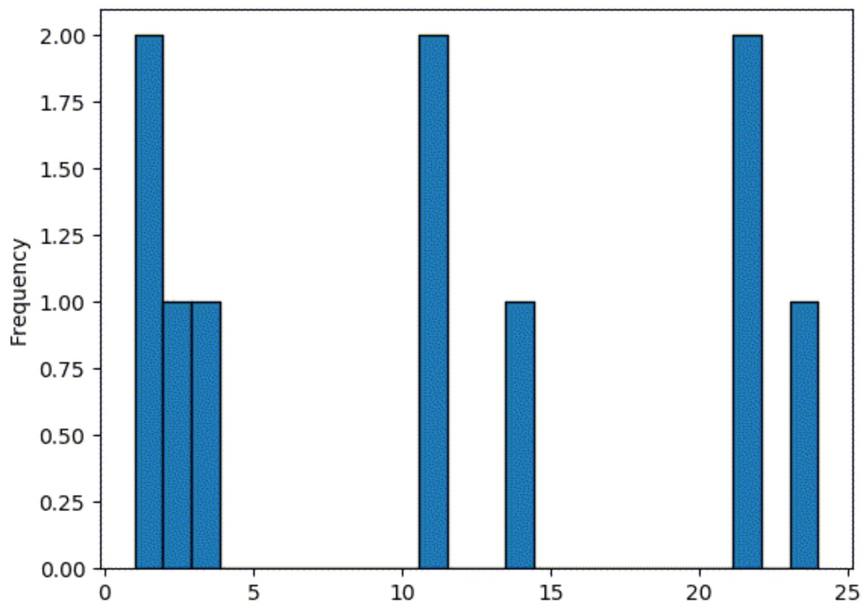
Measures of Spread
Set 1 Set 2
7, 8, 9, 10, 11, 11, 12, 12, 13, 18 1, 1, 2, 3, 11, 11, 14, 22, 22, 24
Notes:
Looking at these graphs provides another way to see how different these two sets are in terms of spread. These graphs are histograms, which lists the frequency (or number of times a number appears) for each number in the set. In set 1, the numbers are pretty much grouped in the middle whereas in set 2, they are very spread out.
There are a few measures that help us determine the spread of a dataset. There’s a bit of math coming up in this lesson but we won’t have to actually calculate these values, since the pandas library will do it for us. It’s still important to know the math behind these measures to understand what they are representing.

Slide 4
Measures of Spread
Standard Deviation: a measure of how spread out a group of numbers are.
Calculated by taking the square root of the variance.
Notes:
The standard deviation is a measure that tells how spread out a group of numbers in a dataset are. This measure can be found by taking the square root of the variance.

Slide 5
Measures of Spread
Standard Deviation: a measure of how spread out a group of numbers are.
Calculated by taking the square root of the variance.
Variance: used to describe how far each number in the dataset is from the mean.
Calculated by determining the average of the squared differences from the mean.
Notes:
The variance is another measure that is used to describe how far EACH number in the dataset is from the mean. This is calculated by determining the average of the squared differences from the mean. Let’s take a look at what this math actually means.

Slide 6
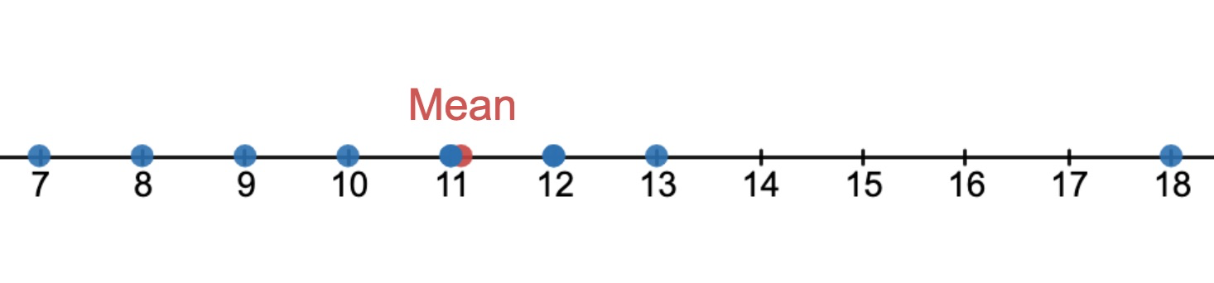
Measures of Spread
Variance: used to describe how far each number in the dataset is from the mean.
Calculated by determining the average of the squared differences from the mean.
Weight | 7 | 8 | 9 | 10 | 11 | 11 | 12 | 12 | 13 | 18
Mean | 11.1 | 11.1 | 11.1 | 11.1 | 11.1 | 11.1 | 11.1 | 11.1 | 11.1 | 11.1
Notes:
Here is our data set, and the mean of this data is 11.1.

Slide 7
Measures of Spread
Variance: used to describe how far each number in the dataset is from the mean.
Calculated by determining the average of the squared differences from the mean.
Weight | 7 | 8 | 9 | 10 | 11 | 11 | 12 | 12 | 13 | 18
Mean | 11.1 | 11.1 | 11.1 | 11.1 | 11.1 | 11.1 | 11.1 | 11.1 | 11.1 | 11.1
Subtract Mean | -4.1 | -3.1 | -2.1 | -1.1 | -0.1 | -0.1 | 0.9 | 0.9 | 1.9 | 6.9
-4.1
-3.1
-2.1
-1.1
-0.1
0.9
1.9
6.9
Notes:
First, we subtract the mean from each dataset, so 7 - 11.1 and then 8 - 11.1 and so forth.

Slide 8
Measures of Spread
Variance: used to describe how far each number in the dataset is from the mean.
Calculated by determining the average of the squared differences from the mean.
Weight | 7 | 8 | 9 | 10 | 11 | 11 | 12 | 12 | 13 | 18
Mean | 11.1 | 11.1 | 11.1 | 11.1 | 11.1 | 11.1 | 11.1 | 11.1 | 11.1 | 11.1
Subtract Mean | -4.1 | -3.1 | -2.1 | -1.1 | -0.1 | -0.1 | 0.9 | 0.9 | 1.9 | 6.9
Square it | 16.81 | 9.61 | 4.41 | 1.21 | 0.01 | 0.01 | 0.81 | 0.81 | 3.61 | 47.61
Notes:
Then we square these values. This is important since we don’t want our negative values and positive values cancelling each other out. Squaring the numbers gets rid of the negatives.

Slide 9
Measures of Spread
Variance: used to describe how far each number in the dataset is from the mean.
Calculated by determining the average of the squared differences from the mean.
Weight | 7 | 8 | 9 | 10 | 11 | 11 | 12 | 12 | 13 | 18
Mean | 11.1 | 11.1 | 11.1 | 11.1 | 11.1 | 11.1 | 11.1 | 11.1 | 11.1 | 11.1
Subtract Mean | -4.1 | -3.1 | -2.1 | -1.1 | -0.1 | -0.1 | 0.9 | 0.9 | 1.9 | 6.9
Square it | 16.81 | 9.61 | 4.41 | 1.21 | 0.01 | 0.01 | 0.81 | 0.81 | 3.61 | 47.61
Variance = (16.81 + 9.61 + 4.41 + 1.21 + 0.01 + 0.01 + 0.81 + 0.81 + 3.61 + 47.61) ➗ (10 - 1)
Notes:
Now, we take the average of these final numbers, but instead of dividing by the number of data values, we divide by the number minus 1. In this case,there are 10 values - so we will divide by 10 - 1 or 9. There is a pretty sophisticated reason for doing this which is quite complicated and not in the scope of this course, but we encourage you to check it out if you are interested!

Slide 10
Measures of Spread
Variance: used to describe how far each number in the dataset is from the mean.
Calculated by determining the average of the squared differences from the mean.
Weight | 7 | 8 | 9 | 10 | 11 | 11 | 12 | 12 | 13 | 18
Mean | 11.1 | 11.1 | 11.1 | 11.1 | 11.1 | 11.1 | 11.1 | 11.1 | 11.1 | 11.1
Subtract Mean | -4.1 | -3.1 | -2.1 | -1.1 | -0.1 | -0.1 | 0.9 | 0.9 | 1.9 | 6.9
Square it | 16.81 | 9.61 | 4.41 | 1.21 | 0.01 | 0.01 | 0.81 | 0.81 | 3.61 | 47.61
Variance = 9.43
Notes:
This gives us a variance of 9.43. The lower the variance, the less spread out the data is.

Slide 11
Measures of Spread
Weights (in pounds) of cats: 7 8 9 10 11 11 12 12 13 18
Standard Deviation: a measure of how spread out a group of numbers are.
Calculated by taking the square root of the variance.
Variance = 9.43
Standard Deviation = √9.43 = 3.07
Notes:
Since we have the variance now, we can take the square root to find the standard deviation. Remember that the variance describes how dispersed EACH number is while the standard deviation tells how dispersed the GROUP of numbers are. Again, the lower this value, the less spread out the numbers are.

Slide 12
Measures of Spread
Set 1 Set 2
7, 8, 9, 10, 11, 11, 12, 12, 13, 18 1, 1, 2, 3, 11, 11, 14, 22, 22, 24
Standard Deviation = 3.07 Standard Deviation = 9.21
Notes:
If we go back to the two datasets that we explored the spread of earlier, we can see that the standard deviation of set 2 is a lot higher since many of the values were pretty far from the mean value.

Slide 13
Measures of Spread
Range: the difference between the largest number and the smallest number.
The larger the range, the larger the spread or dispersion.
Notes:
There are two more measures of spread that are important. The range, which may sound familiar, and the interquartile range. The range is found by subtracting the minimum value from the maximum value. Again, the larger this number, the larger the spread.

Slide 14
Measures of Spread
7 8 9 10 11 11 12 12 13 18
Range = maximum value - minimum value
Notes:
Let’s use an example to better understand the range. Here, we determine the max and min values and subtract them.

Slide 15
Measures of Spread
7 8 9 10 11 11 12 12 13 18
Range = maximum value - minimum value
Range = 18 - 7
Range = 11
Notes:
The minimum of 7 is subtracted from the maximum of 18 which gives us a range of 11.

Slide 16
Measures of Spread
Interquartile Range (IQR): the difference between the first and third quartiles.
Indicates how spread out the middle 50% of the set of data is.
Helps to avoid outliers affecting the data
Notes:
The interquartile range is a bit more specific. Quartiles split the data into four sets. The interquartile range, or IQR for short, is found by finding the range of the middle 50% of the data. This helps to avoid outliers from affecting the data.

Slide 17
Measures of Spread
Interquartile Range (IQR): the difference between the first and third quartiles.
Indicates how spread out the middle 50% of the set of data is.
Helps to avoid outliers affecting the data
First Quartile: median of the first half of the data (25%)
Notes:
The first quartile is the 25% point in the data, or half of the first half

Slide 18
Measures of Spread
Interquartile Range (IQR): the difference between the first and third quartiles.
Indicates how spread out the middle 50% of the set of data is.
Helps to avoid outliers affecting the data
First Quartile: median of the first half of the data (25%)
Third Quartile: median of the second half of the data (75%)
Notes:
and the third quartile is the 75% point of the data, or half of the second half. If you are wondering where the 2nd quartile is - it’s the same as the median, which is the 50% point. Let’s take a look an an example to better demonstrate these two measures.

Slide 19
Measures of Spread
7 8 9 10 11 11 12 12 13 18
Notes:
To find the IQR, we’ll need to split this data into four sections. The median is 11 and splits the data into two sets of 5 values.

Slide 20
Measures of Spread
7 8 9 10 11 11 12 12 13 18
Notes:
If we look at just the first half, the middle number here is 9 - this is the first quartile.

Slide 21
Measures of Spread
7 8 9 10 11 11 12 12 13 18
First Quartile = 9
Notes:
Doing the same to the second half of the data gives us 12 as the third quartile.

Slide 22
Measures of Spread
7 8 9 10 11 11 12 12 13 18
First Quartile = 9
Third Quartile = 12
Notes:
Now, we can take these two values and subtract them to get the interquartile range.

Slide 23
Measures of Spread
7 8 9 10 11 11 12 12 13 18
First Quartile = 9
Third Quartile = 12
Interquartile Range = Third Quartile - First Quartile
Interquartile Range = 12 - 9
Interquartile Range = 3
Notes:
12 - 9 gives us an interquartile range of 3. So, if the range was 11 and the IQR is 3, this tells us that the middle 50% of the data is less spread out than the dataset as a whole.

Slide 24
Measures of Spread
Range
7 8 9 10 11 11 12 12 13 18
IQR
Notes:
So the range represents the whole dataset, whereas the IQR provides information about the middle 50%. Both measures can be useful in exploring and finding meaning or patterns within a dataset.

Slide 25
Boxplots
import matplotlib.pyplot as plt
Notes:
If all of these measures, numbers, and percentages are confusing, there is a visual approach to looking at the measures of spread! This visual is called a boxplot and pandas, along with a new library can plot one for us. This new library is called matplotlib.pyplot and we will import the library and use an abbreviation of plt.

Slide 26
Boxplots
import matplotlib.pyplot as plt
cats = pd.Series([7, 18, 12, 9, 11, 8, 10, 11, 12, 13])
Notes:
We still use pandas to create the series and now can call a function to create a boxplot.

Slide 27
Boxplots
import matplotlib.pyplot as plt
cats = pd.Series([7, 18, 12, 9, 11, 8, 10, 11, 12, 13])
plt.boxplot(cats)
Notes:
Plt denotes the library - dot boxplot is the function - and cats is the data series.

Slide 28
Boxplots
import matplotlib.pyplot as plt
cats = pd.Series([7, 18, 12, 9, 11, 8, 10, 11, 12, 13])
plt.boxplot(cats)
plt.show()
Notes:
Lastly, instead of printing this result, we use the function plt.show() to graph the boxplot.

Slide 29
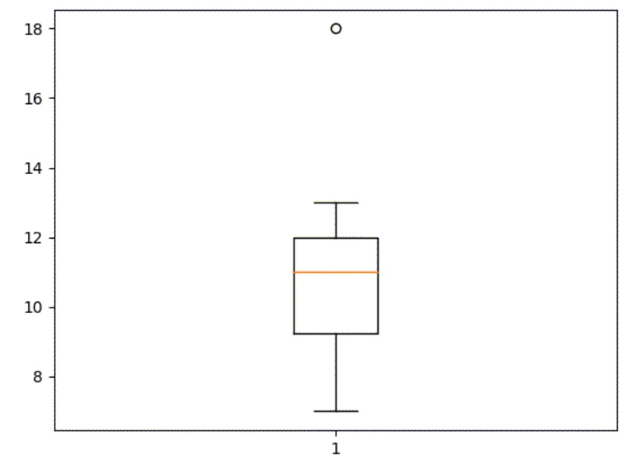
Boxplots
import matplotlib.pyplot as plt
cats = pd.Series([7, 18, 12, 9, 11, 8, 10, 11, 12, 13])
plt.boxplot(cats)
plt.show()
Outlier
Maximum
Third Quartile
Median
First Quartile
Minimum
Notes:
Very cool. But what is this actually showing us? Well, first off matplotlib recognized our value of 18 as an outlier all the way up here. The beginning and the end of the arms of the boxplot show the maximum and minimum values. The line in the middle is the median. And lastly, the tops and bottom of the box denotes the first and the third quartiles!

Slide 30
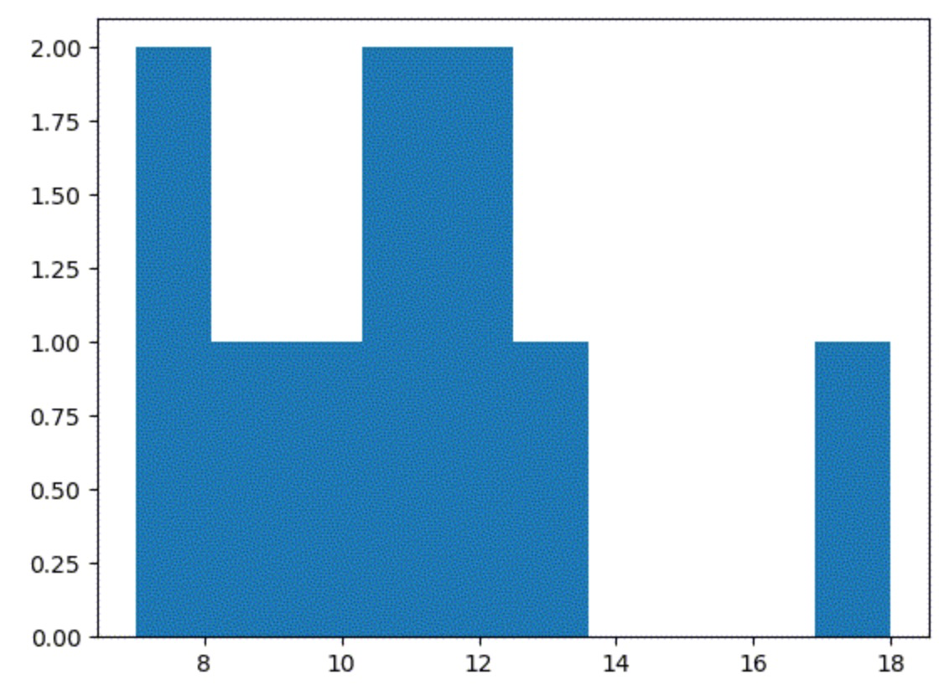
Histogram
import matplotlib.pyplot as plt
cats = pd.Series([7, 18, 12, 9, 11, 8, 10, 11, 12, 13])
plt.hist(cats)
plt.show()
Notes:
We can also view the data as a histogram. The only thing that changed here in the code is replacing the “boxplot” function with a histogram, or “hist” function. The bars here seem to all combine together which makes it hard to see each one. There are lot of customizations that can be done using the pandas and matplotlib libraries. One that will help here is the edgecolor parameter.

Slide 31
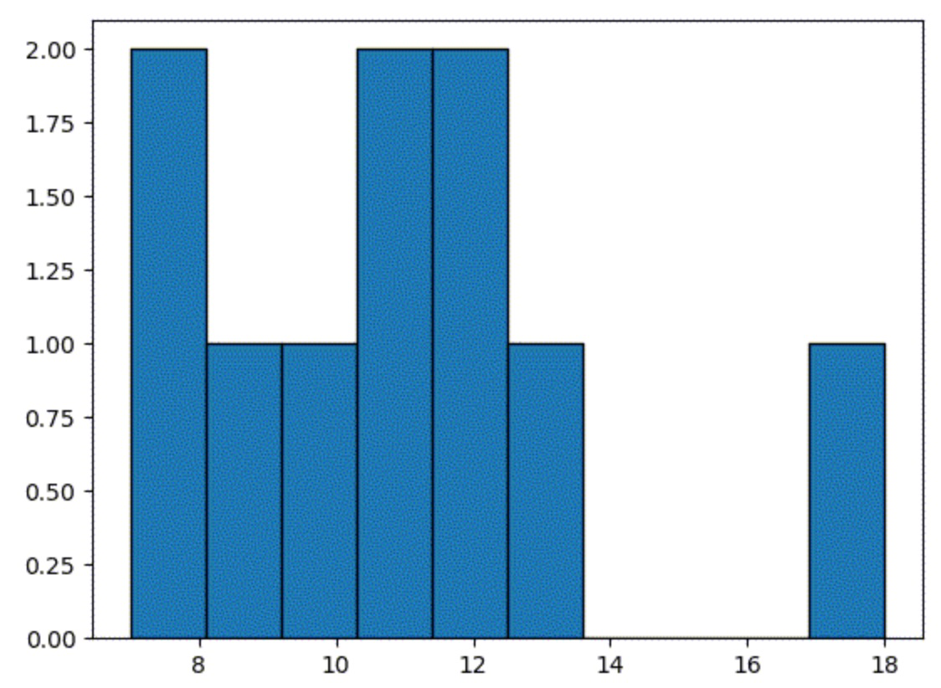
Histogram
import matplotlib.pyplot as plt
cats = pd.Series([7, 18, 12, 9, 11, 8, 10, 11, 12, 13])
plt.hist(cats, edgecolor="black")
plt.show()
Outlier
Notes:
We can add in a comma after the dataset and specify the color that we’d like the edgecolor to be. This provides a much nicer graph. You won’t be able to determine the median or mean as easily in a histogram as a boxplot, but you can still see the outlier and can easily spot values that appear more than once. A histogram also provides you with a pretty good visual of the spread of the data.

Slide 32
Lesson Vocabulary
Term | Definition
measure of spread | Used to describe how data is spread. It also describes the variability of the dataset.
standard deviation | A measure of how spread out a group of numbers are, calculated by taking the square root of the variance.
variance | Used to describe how far each number in the dataset is from the mean and calculated by determining the average of the squared differences from the mean.

Slide 33
Lesson Vocabulary
Term | Definition
range | The difference between the largest number and the smallest number. The larger the range, the larger the spread or dispersion.
interquartile range (IQR) | The difference between the first and third quartiles. Indicates how spread out the middle 50% of the set of data is. Helps to avoid outliers affecting the data.
first quartile | Median of the first half of the data or the 25% point.
third quartile | Median of the second half of the data or the 75% point.

Slide 34
Without performing any calculations, which data set will most likely have the greatest measures of spread?
Notes:
🍐 This is a Pear Deck Multiple Choice Slide. Your current options are: A: 4, 5, 6, 7, 7, 9, B: 300, 301, 302, 307, C: 45, 78, 98, 104, D: 15, 17, 19, 20, 25,
🍐 To edit the type of question or choices, go back to the "Ask Students a Question" in the Pear Deck sidebar.

Slide 35
Which dataset has a range of 12?
Notes:
🍐 This is a Pear Deck Multiple Choice Slide. Your current options are: A: 2, 3, 6, 8, 10, B: 5, 10, 15, 17, C: 2, 3, 7, 9, 16, D: 5, 7, 8, 10, 15,
🍐 To edit the type of question or choices, go back to the "Ask Students a Question" in the Pear Deck sidebar.

Slide 36
Which dataset has an interquartile range (IQR) of 10?
Notes:
🍐 This is a Pear Deck Multiple Choice Slide. Your current options are: A: 3, 5, 8, 9, 13, 15, 20, B: 2, 6, 8, 11, 12, 15, 19, C: 1, 3, 6, 10, 11, 14, 18, D: 4, 5, 7, 10, 12, 19, 19,
🍐 To edit the type of question or choices, go back to the "Ask Students a Question" in the Pear Deck sidebar.

